Slide 1
Towards Online Waypoint Generation for a Quadrotor Using Enhanced Monocular Depth Estimation
(CMSC 828i Fall 2021)
Paras Savnani, Naitri Rajyaguru
Arunava Basu, Hirunima Jayasekara

Slide 2
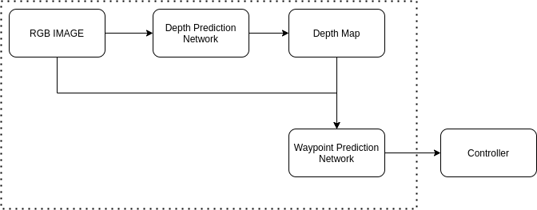
Problem Statement
Predict the waypoints for a quadrotor using Monocular RGB inputs for obstacle avoidance task.
Improve the Depth Estimation pipeline by modifying the DenseDepth Network and achieve better performance than the baseline.

Slide 3
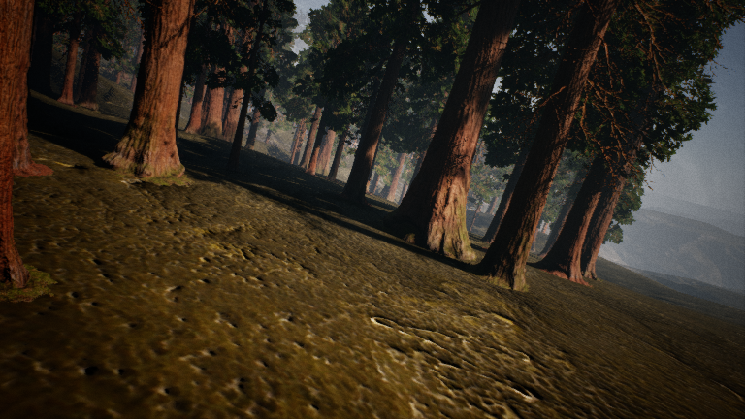
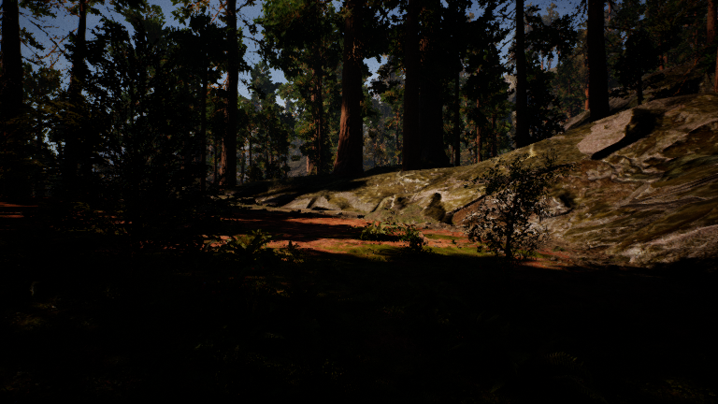
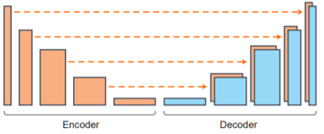
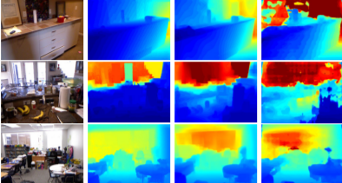
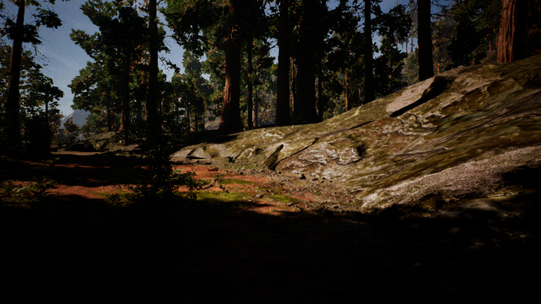
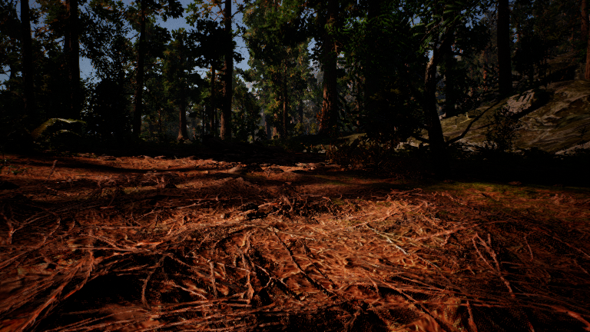
Related Work
High Quality Monocular Depth Estimation via Transfer Learning Used as the base network for the depth estimation due to the stability of the network.
Multi-Task Regression-based Learning for Autonomous Unmanned Aerial Vehicle Flight Control within Unstructured Outdoor Environments Customized dataset for autonomous navigation was presented in the paper.
Following networks were studied as the early part of the project.
Towards Robust Monocular Depth Estimation: Mixing Datasets for Zero-shot Cross-dataset Transfer
Unsupervised Monocular Depth Estimation with Left-Right Consistency
Learning High-Speed Flight in the Wild
Vision Transformers for Dense Prediction
DenseDepth Estimation[1]
Custom Regression Dataset [2]

Slide 4
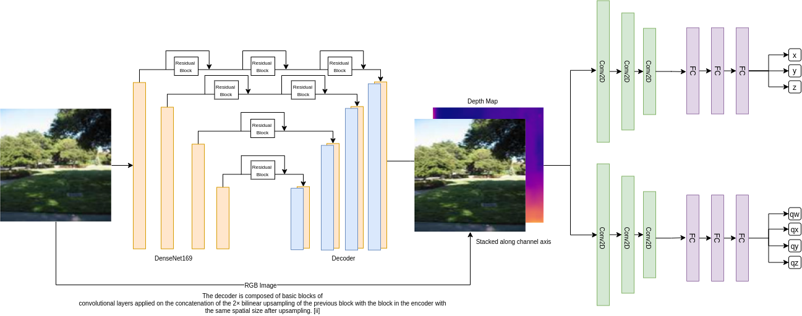
Architecture Designs

Slide 5
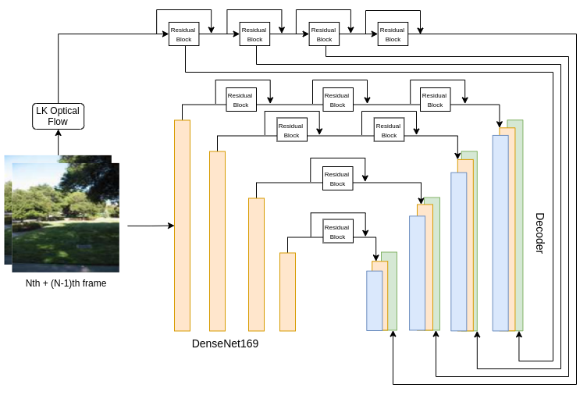
Architecture Designs continued …

Slide 6
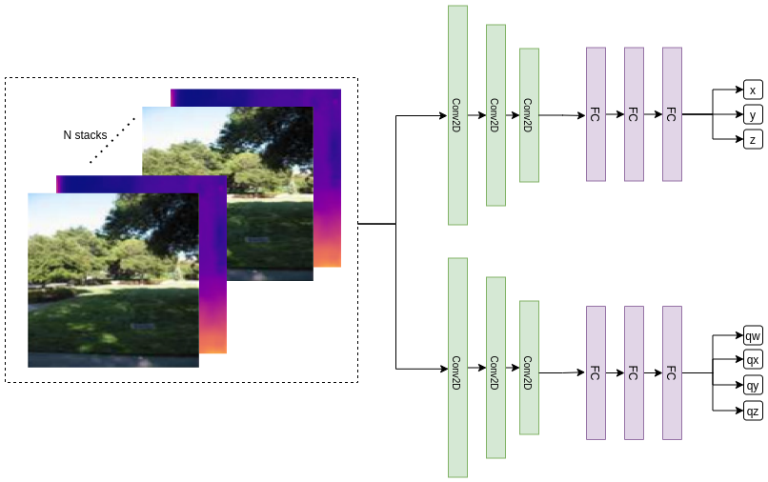
Architecture Designs continued …

Slide 7
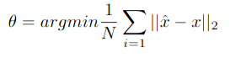
Approach: WPNet
Regression Estimation (CNN Downsampling block):
First Trial: Prediction based on Depth Image
Second Trial: Prediction based on RGB+Depth
Third Trial: Prediction based on temporally stacked RGB+Depth Images
Multi-Task Regression on image for Cartesian and Quaternion coordinates.
Dataset: Custom Regression Dataset
Loss: MSEloss()
Frame stacking to predict multiple waypoints simultaneously (include temporal data for each prediction).

Slide 8
Approach : Depth Network
Depth Estimation Network :
We used the PyTorch library for the development of the model. We trained the network for 287,500 iterations with a batch size of 4 on a NVIDIA V100 with 16G of memory on a 50K subset of the NYUv2 dataset provided by the authors of Densedepth [1].
Dataset: NYUDepth_v2 subset
Loss:
The optimizer used was Adam with a learning rate of 0.0001 with a exponential weight decay factor of 0.1 per epoch.

Slide 9
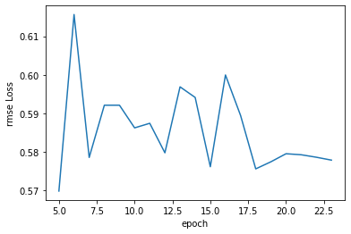
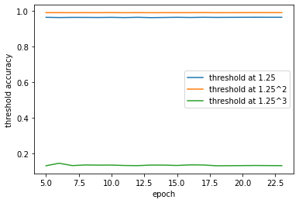

Results : Depth Network
RMSE Loss for Depth Estimation
Threshold accuracy for Depth Estimation
Average relative error for Depth Estimation

Slide 10
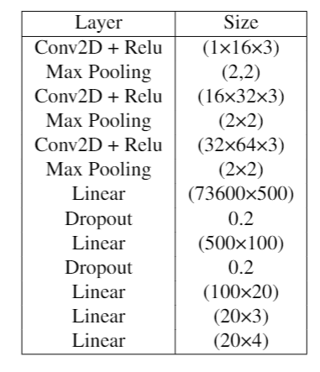
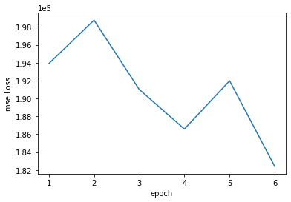
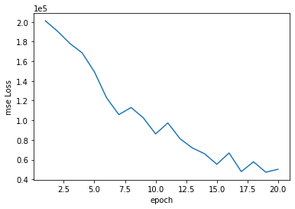
Results: Waypoint Prediction Network
MSELoss for input as Depth
MSELoss for input as RGBD
Network Details

Slide 11
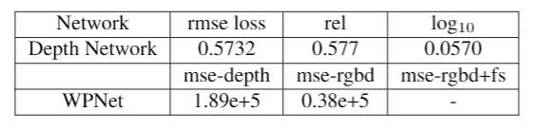

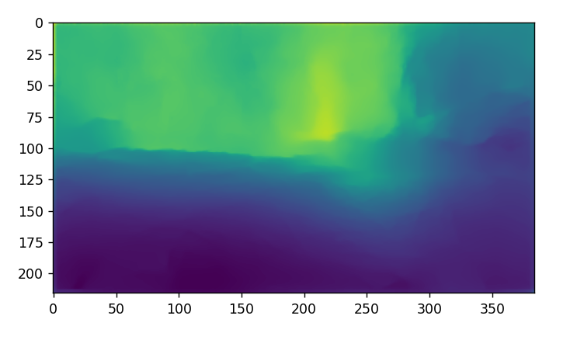
Results continued …
Sample prediction on the obstacle avoidance dataset. The model is trained on NYU dataset.
RGB input
Depth Prediction

Slide 12
Future Work
2 weeks -
Coding another evaluation metric for waypoint prediction: Collision free distance moved
Improvement over the DenseDepth baseline.
2 months -
Change the Encoder-Decoder part of the DenseDepth to a more parameter efficient architecture (like MobileNet) without compromising the baseline performance.
Add a traditional controller like LQR over the waypoint predictions.
Combining optical flow prediction between neighbouring frames with depth maps.
1 semester -
Try different configurations of residual blocks and convolutionals blocks in the skip connections to explore the degree to which they can affect the output.
Instead of using the traditional controller - Learn the controller using a Deep Learning Backbone and achieve end-to-end learning (Image to control policy) (Generate custom dataset)

Slide 13
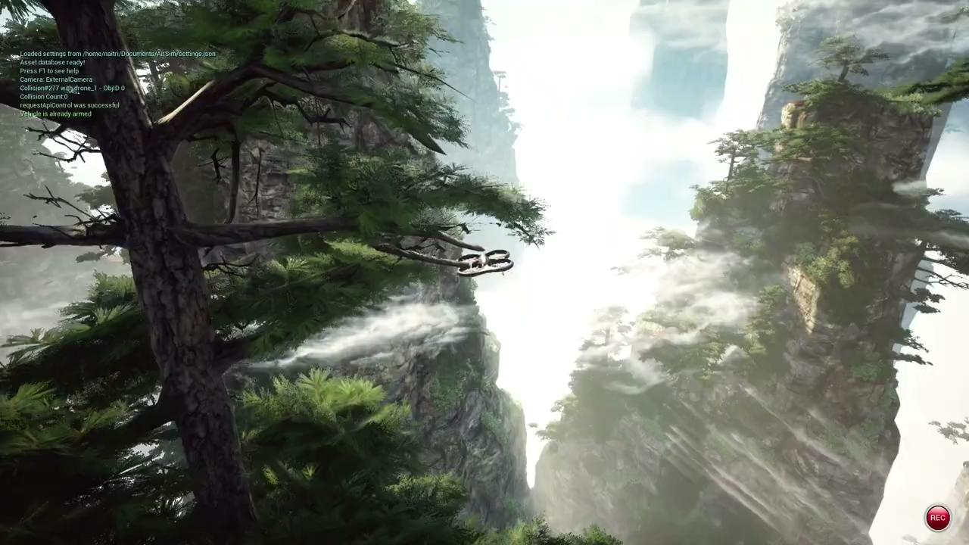
Simulating the network output on Microsoft AirSim

Slide 14
Issues
Convergence of WPNet
WPNet learning very slowly: Resolution approaches - Add Batchnorm, Decrease Weight decay, Use bigger subset of data to prevent overfit
Convergence of Novel Depth Network
End to end training not possible
Official baseline for DenseDepth does not match with rmse.
No standard metric and baseline score for waypoint trajectory prediction.
Hardware bottleneck

